Slide 1
Marginal Costing and Cost Volume Profit Analysis

Slide 2
Learning Outcomes
Appraise the technique of marginal costing used in product costing.
Apply the concepts of marginal costing and CVP analysis in business decision making.

Slide 3
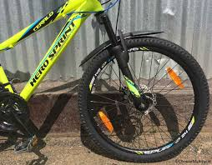
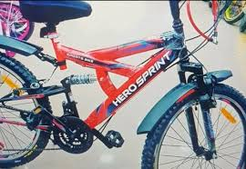
Opening Case Costing of ‘Sprint’ by Hero Cycles
Hero Cycles is engaged in manufacturing of ‘Sprint cycle’, a specialty cycle meant for city rides.
It produces 1000 units of ‘Sprint’ cycles by incurring the total cost of $150,000.
The break – up of costs is presented as follows:
Material costs $60 per cycle
Labor costs $40 per cycle
Variable Overheads $20 per cycle
Fixed costs were $30000

Slide 4
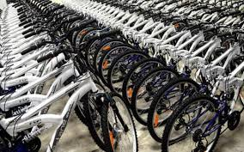
Opening Case Costing of ‘Sprint’ by Hero Cycles
Hero Cycle wants to find the cost of producing one more unit of ‘Sprint’ cycle.
The analysis is presented as follows:
Particulars | 1000 Units (A) | 1001 Units (B) | Change in cost (B) – (A)
Material @60/cycle | 60,000 | 60060 | 60
Labor @40/cycle | 40,000 | 40,040 | 40
Variable Overheads @20/cycle | 20,000 | 20,020 | 20
Fixed Overheads | 30,000 | 30,000 | No Change
Total Cost | $150,000 | $150,120 | $120

Slide 5
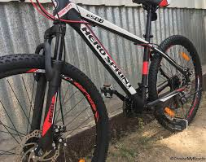
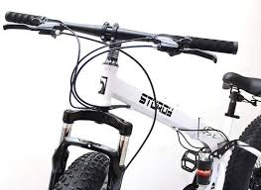
What Hero Cycles is doing?
Adopting the system of ‘Marginal Costing’
Fixed Costs
Ignored in decision making
Variable Costs
Forms the part of product

Slide 6
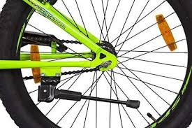
Poll – I
Hero Cycles is currently manufacturing 1000 units of Sprint cycles and is following the technique of marginal costing for its cycles.
Which of the following statements are ‘true’ with regard to marginal costing technique?
Total fixed costs remains constant irrespective of number of cycles manufactured in factory.
All the elements of costs are divided into fixed costs and variable costs.
Per unit variable costs remains constant at all the levels of production of cycles.
All of the above
Notes:
d

Slide 7
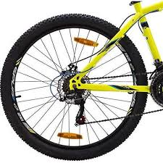
2. Case Analysis Costing of ‘Sprint’ by Hero Cycles
Hero Cycles is looking to increase its profitability. It seeks to have a better understanding of the behavior of sales, number of cycles produced and cost incurred.
Following is the information given for the current quarter:
The Selling Price (per cycle) set by Hero Cycles for ‘Sprint’ is $200.
The Variable cost (per cycle) set by Hero Cycles for ‘Sprint’ is $120.
The Fixed costs are $2000.
How many units of Sprint Cycles, Hero Cycles must sell in order to earn ‘profits’?

Slide 8
2. Case Analysis Costing of ‘Sprint’ by Hero Cycles
How many units of Sprint Cycles, Hero Cycles must sell in order to earn ‘profits’?
Changes in Selling Prices
CVP Analysis
Changes in Sales volume
Impact
Profits
Changes in variable costs
Changes in Fixed Costs

Slide 9
Techniques of CVP Analysis
Marginal Cost Equation
Contribution Margin
Profit Volume ratio
Break Even Point
Margin of Safety

Slide 10
A.) Developing ‘Marginal Cost of Equation’
Sales – Cost = Profit
Sales – {Fixed Cost + Variable Cost} = Profit
Sales - Variable Cost = Fixed Cost + Profit
OR
S – VC = FC + P

Slide 11

Poll – II
Dabur India has following particulars related to manufacturing of Real fruit juices.
Sales Rs. 240,000, Direct materials Rs. 80,000, Direct labor = Rs. 70,000 and Profit earned is Rs. 50,000
The ‘fixed expenses’ of the company (in Rs.) will be:
40,000
60,000
50,000
100,000

Slide 12
B.) Contribution Margin of Sprint Hero Cycles
 |  | Number of Hero Sprint Cycles
Particulars | Per Unit Cost $ | 0 units | 5 units | 25 units | 40 units
Sales Revenue | 200 | 0 | $1000 | $5000 | $8000
- Variable Cost | 120 | 0 | 600 | 3000 | 4800
Contribution Margin | 80 | 0 | 400 | 2000 | 3200
- Fixed Costs | 2000 | 2000 | 2000 | 2000 | 2000
Profit |  | $(2,000) | $(1,600) | $0 | $1,200
Notes:
Contribution will first go to meet FC and then to earn profits.

Slide 13
B.) Contribution Margin
Refers to earnings available to cover fixed costs of the business.
Calculation in terms of ‘Total Terms’
Sales Revenue – Variable Cost
Calculation in ‘Per Unit’ terms
Selling Price/unit – Variable Price/unit
Fixed Cost + Profit

Slide 14
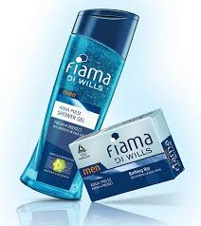
Poll – III
ITC is manufacturing Fiama Di Wills, a soap gel at the variable cost of Rs. 40 per unit.
Each unit of soap is sold in the market at Rs. 100 per unit.
In last month 500 units of soaps were manufactured.
The fixed costs of the company were Rs. 10,000.
In such case, the profits earned by the company will be:
10,000
20,000
30,000
40,000

Slide 15
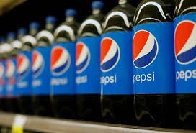
Poll based on previous lecture
PepsiCo India has following particulars related to manufacturing of Pepsi.
Sales Rs. 500,000, Variable cost = Rs. 350,000 and Profit earned is Rs. 100,000
The ‘fixed expenses’ of the company (in Rs.) will be:
20,000
60,000
50,000
80,000

Slide 16
Learning Outcomes
Apply the concepts of CVP analysis in business decision making.

Slide 17
Techniques of CVP Analysis
Marginal Cost Equation
Contribution Margin
Profit Volume ratio
Break Even Point
Margin of Safety

Slide 18
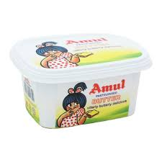
Calculating profits of Amul
Amul India is manufacturing ‘Butter’ and ‘Margarine’ in last quarter year 2020.
The cost related information is presented as follows:
Which is most profitable product out of two?
Particulars | Butter | Margarine
Selling cost/unit | 100 | 150
Material cost/unit | 20 | 15
Labor cost/unit | 10 | 20
Variable Overheads | 5 | 10
Number of units manufactured | 40 | 35
Total Fixed Overheads | Rs. 2000

Slide 19

Poll – I
Dabur India is manufacturing Dabur Honey, at the variable cost of Rs. 80 per unit.
Each unit is sold in the market at Rs. 400 per unit.
In last month 200 units were manufactured.
The fixed costs of the company were Rs. 4,000.
In such case, the profits earned by the company will be:
60,000
64,000
70,000
16,000

Slide 20
C.) Profit – Volume Ratio
Also known as Contribution/Sales ratio.
Used to measure profitability of each product, so that the necessity for continuance of such production can be examined.
P/V ratio = Contribution _{* 100 OR} Sales – Variable Cost _{* 100 OR} Fixed Costs +Profit _{* 100}
Sales Sales Sales
When Sales and profits are given for two periods
P/V ratio = Change in profit
Change in Sales

Slide 21
3. Case Analysis Costing at Hero Cycles
‘Dominator’, ‘Attitude’ and ‘Black Pearl’ are the three popular brands manufactured by Hero Cycles.
The per unit information related to three brands are listed below:
Particulars | Dominator | Attitude | Black Pearl
Sales Price | $110 | $120 | $210
Variable Cost | $60 | $70 | $160
Contribution
P/V ratio

Slide 22
Poll – II
Following is the information related to Grasim Industries for the previous two years:
In such case, the P/V Ratio of the company will be:
20%
30%
40%
50%
Year | Sales | Net Profit
2019 | 20,000 | 1,000
2020 | 22,000 | 1,600
Notes:
b

Slide 23
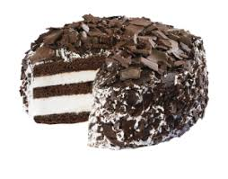
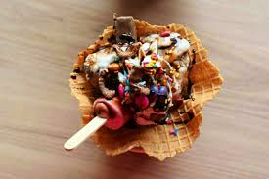
P/V Ratio of Havmor
Havmor is manufacturing three different varieties of chocolate flavored ice-creams.
The cost and sales information is listed below:
Comment on the profitability of each product based on P/V ratio
Particulars | Chocolate Chips | Chocolate Truffle | Chocolate Cookie
Selling Price/unit | 10 | 20 | 25
Variable Cost/unit | 4 | 8 | 6
Number of units | 2000 | 2500 | 3500
Total Fixed Costs = Rs. 15000

Slide 24
P/V Ratio of Colgate Palmolive
Colgate Palmolive (India) Limited is selling the ‘Colgate Sensitive’ at the selling price of Rs. 125 per unit.
The total fixed costs used in manufacturing the toothpastes are Rs. 5000.
In last quarter, 400 units were actually manufactured and profit earned on sale was Rs. 8000.
What will be the P/V ratio of ‘Colgate Sensitive’ toothpaste in such case?

Slide 25

Poll
The costing information is given related to two products manufactured by HUL.
In such case the P/V ratio of these two products will be:
80% and 72%
60% and 77%
65% and 75%
77% and 60%
Particulars | Lipton | Brooke Bond
Selling Price/unit | 150 | 180
Variable manufacturing overhead | 40 | 30
Variable selling overhead | 20 | 10
Fixed Overheads | Rs. 5000

Slide 26


A.) Break – even Point of ITC’s Savlon
ITC has introduced germ protection wipes under it’s Savlon brand.
ITC wants to ascertain how many units of wipes it must sell so that:
It covers all of its variable and fixed costs.
It earns profits.

Slide 27
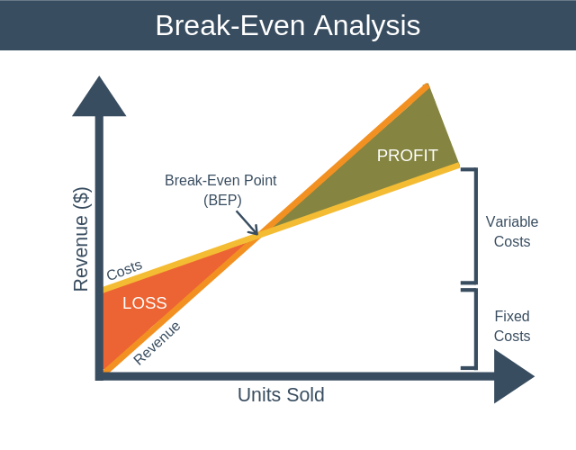
Break – even Point of ITC’s Savlon
Point at which Total Sales = Total Costs
Point of No Profit No Loss

Slide 28
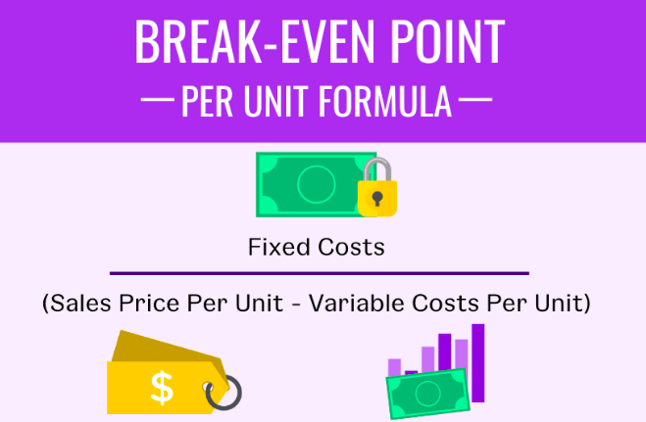
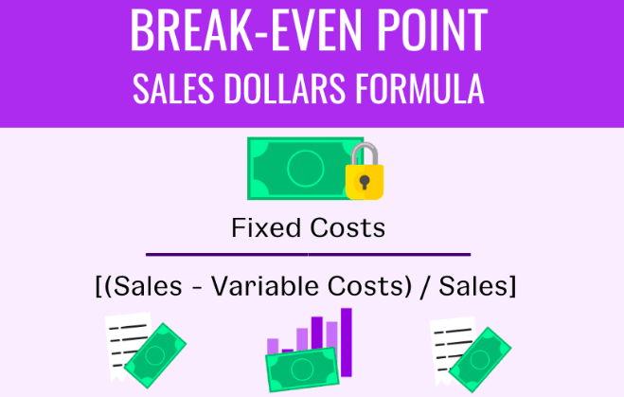
Calculating Break – even point of Savlon

Slide 29

Break – even Point of ITC’s Savlon
ITC has presented the following cost and sales information related to Savlon Germ protection wipes.
Selling price/unit is Rs. 50
Variable manufacturing overhead/unit is Rs. 15
Variable selling overhead is Rs. 10
Fixed overheads are Rs. 6000
What will be the break – even point (in units) and (in Sales value) of Savlon?

Slide 30

Poll
ITC is manufacturing Charmis skin care cream which caters the moisturization needs of skin.
The selling price/unit is Rs. 150 and the variable manufacturing cost/unit is Rs. 60.
The fixed factory overheads were Rs. 90,000.
The number of Charmis creams which ITC must sell to ‘break even’ will be:
1500 units
1000 units
2500 units
1200 units
Notes:
b

Slide 31
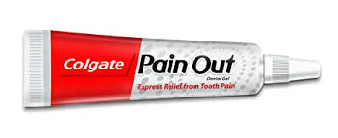
B.) Margin of Safety of Colgate’s Pain Out
Colgate Palmolive has launched ’Pain Out’, a new toothpaste which provides active protection against gum disease and prevents tooth ache.
It achieved it’s break – even point by selling 400 units and making the break – even sales of Rs. 200,000
Currently, It is selling 500 units and achieved the total sales of Rs. 250,000.
Margin of Safety = Actual Sales – Break even Sales
Margin of Safety = 250,000 – 200,000
Margin of Safety = Rs. 50,000

Slide 32
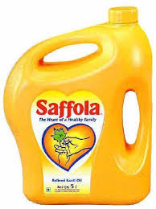
Poll
Marico presents the following information related to the Saffola cooking oil.
In such case, the break – even point (in units) will be:
6000 units
6500 units
7500 units
7000 units
Particulars | Amount (in Rs.)
Sales (8000 units) | 66000
Less: Variable costs | 34000
Contribution | 32000
Less: Fixed costs | 26000
Profit for the year | 6000
Notes:
b

Slide 33
C.) Calculating ‘Desired Profits’
a) Number of units (must be sold) = Fixed Costs + Desired Profit
Contribution per unit
b) Total Sales (to be made) = Fixed Costs + Desired Profit
P/V Ratio

Slide 34

Poll
Nestle India is selling each unit of ‘Munch’ chocolate at Rs. 5 per unit.
The total fixed overheads are Rs. 200,000 and variable manufacturing costs are Rs. 3 per unit.
How many units of ‘Munch’ chocolate must be sold by Nestle India in order to earn desired profit of Rs. 40,000?
100,000 units
200,000 units
250,000 units
120,000 units
Notes:
d

Slide 35
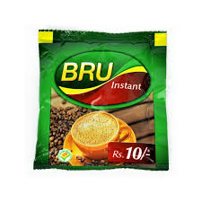
Calculating the Desired Profits of ‘Bru’
Following is the costing information given related to manufacturing of Bru coffee
Calculate the
P/V Ratio
Fixed Costs
Sales required to achieve the desired profit of Rs. 40,000
Particulars | Amount (in Rs.)
Sales | Rs. 100,000
Profit | Rs. 10,000
Variable Cost | 70%
Notes:
30%
Rs. 20,000
Rs. 200,000

Slide 36
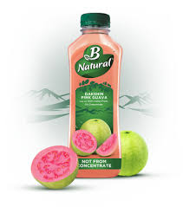
Calculating the Desired Profits of ‘B Natural’
Following is the costing information given related to manufacturing of B Natural Juices
Calculate the
P/V Ratio
Sales required to achieve the desired profit of Rs. 40,000
Profit when sales are Rs. 120,000
Year | Sales (in Rs.) | Profit (in Rs.)
2019 | 140,000 | 15,000
2020 | 160,000 | 20,000
Notes:
25%
Rs. 240,000
Rs. 10,000

